Slide 1
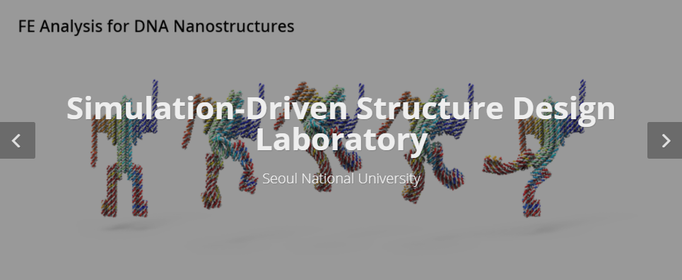
PINN Papers Summary
Jiwon Kang
MS-PhD Program of Mechanical Engineering
Seoul National University, South Korea

Slide 2
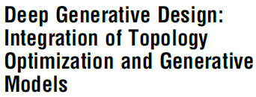

1. TO+GAN
2. GOALS
2. TOuNN

Slide 3
Main Idea
1. TO+GAN
Drawbacks in conventional Generative Design (TO)
- Do not use AI
- Unable to create aesthetic designs but only focus on engineering performance
- Low diversity
2. TOuNN
Drawbacks of the Generative models (VAE, GAN, Auto-Encoder)
- Difficult to access industrial training data
- Cannot guarantee feasible engineering
- Model collapse (training instability)
Topology optimization
Generative Models

Slide 4
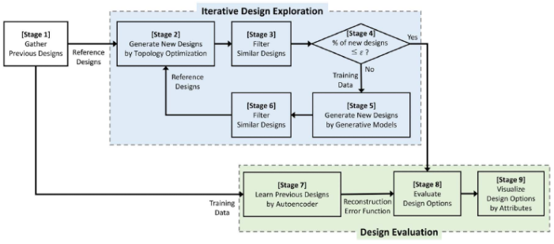
Methodology
1. TO+GAN
2. TOuNN
Stage1: collect previous designs in the market/industry as reference designs

Slide 5
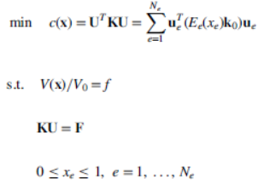
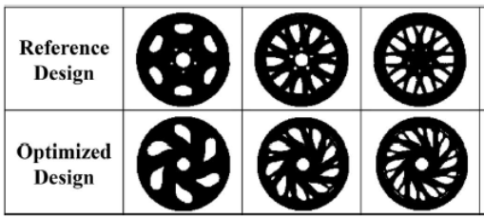
Methodology
Stage2: obtain new designs with TO
1. TO+GAN
1. objective of TO
compliance minimization (engineering performance)
pixel wise L1 distance minimization (aesthetic performance, diversity)
2. TOuNN
2. SIMP (solid isotropic material with penalization) -> well used TO method
calculate material density with minimum compliance related to the stiffness

Slide 6
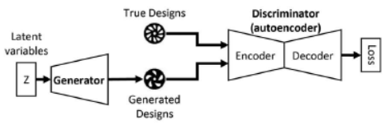
Methodology
Stage3, 6: filter out by the similarity criterion (using L1 distance) → reduce computation
1. TO+GAN
Stage4: if the ratio (# of new designs / # of total designs) smaller than threshold → exit the iterative design exploration → to stage8
2. TOuNN
Stage5: create new designs by generative models → also reference designs for TO in stage 2
Use BEGAN (boundary equilibrium GAN)

Slide 7
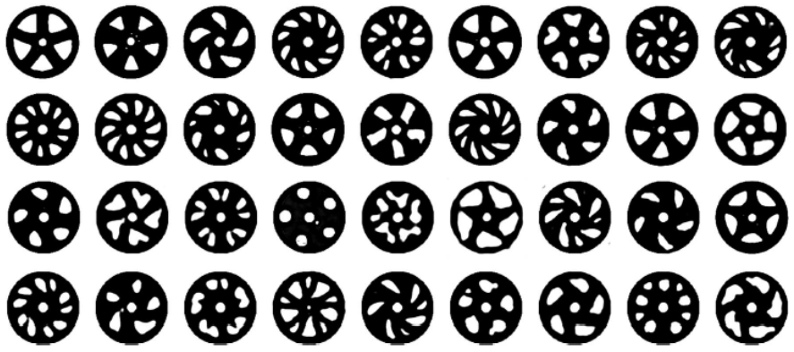
Methodology
Results from BEGAN
1. TO+GAN
2. TOuNN

Slide 8
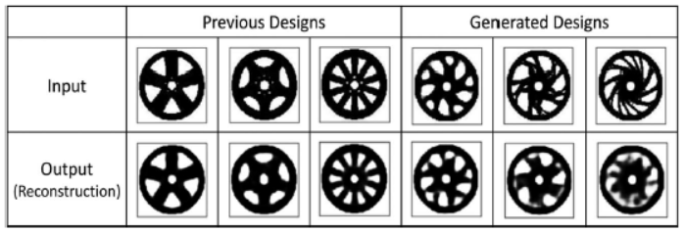
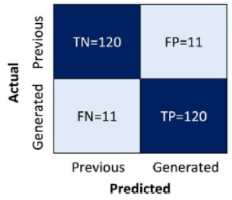
Methodology
Stage7: train auto-encoder with data from stage1 → auto-encoder learn the features of the reference data
→ designs similar to the reference show good reconstruction, dissimilar ones don’t → evaluate design novelty
1. TO+GAN
2. TOuNN
Few FP, FN
Shows the robustness of the auto-encoder
→ Novelty of our design can be well defined

Slide 9
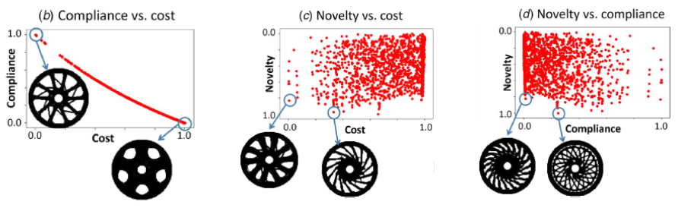
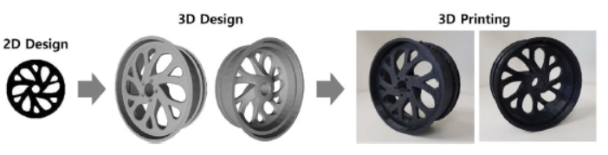
Result
Stage8: Evaluate 3 design attributes (novelty, cost, compliance)
1. TO+GAN
2. TOuNN
3D models from 2D design

Slide 10

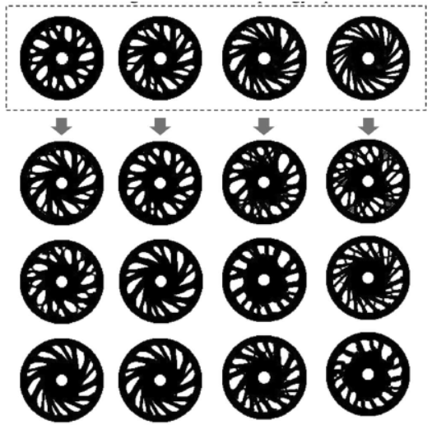
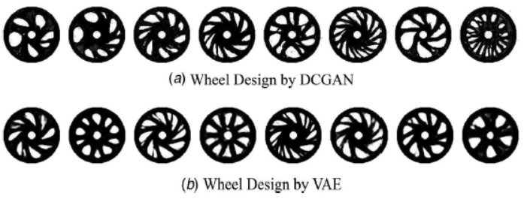
Result
1. TO+GAN
2. TOuNN
TO without the reference designs from stage 1
cannot yield aesthetical diversity
TO without BEGAN (reference only from stage 1)
Poor Results from other generative models

Slide 11
Pros and Cons
Pros
1. TO+GAN
- Considers engineering performance and also aesthetics (novelty)
- Large number of designs starting from a small number of designs
- Diversity of designs
- Data generated from BEGAN passes TO → instability of generative models are solved
→ robustness of the quality can be guaranteed
2. TOuNN
Cons
- Gray area (density not 1 or 0) still exists
- Disconnections still exist

Slide 12


1. TO+GAN
2. GOALS
2. TOuNN

Slide 13
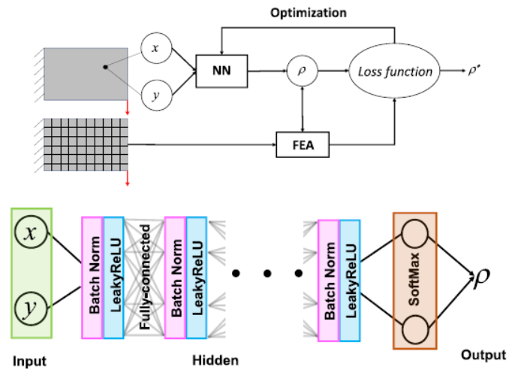
Main Idea
Drawbacks in previous DL applied Generative Design (TO)
- Use NNs only to accelerate topology optimization
-> This work directly execute TO using NNs
1. TO+GAN
2. TOuNN

Slide 14
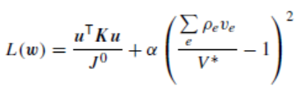
Methodology
Neural Network
- output of NN: density value at a point
- softmax at the end to ensure the density to lie between 0 and 1
- Glorot normal initialization for weight/bias
1. TO+GAN
2. TOuNN
FEA (Finite element analysis)
- regular 4 node quad element
- fast Cholesky factorization based on the CVXOPT library
- compute the stiffness matrix for each element based on the density at the center of the element
→ assemble global stiffness matrix → compute displacement vector u, compliance of each element
→ compute total compliance
3. Loss function
alpha: penalty parameter, J0: initial compliance
alpha → start from a small positive value → increase iteratively

Slide 15
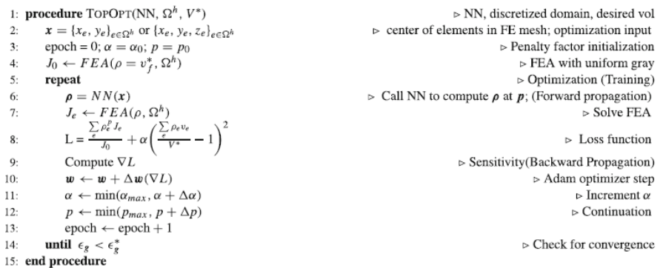
Methodology
Algorithm
1. TO+GAN
2. TOuNN
- initialize the penalty parameter alpha, SIMP parameter p
- compute element densities with NN
- FE solve to calculate compliances
- compute the loss function and the gradients
- update weight/bias and the parameters
- repeat until termination → when the percentage of gray elements is less than a threshold

Slide 16
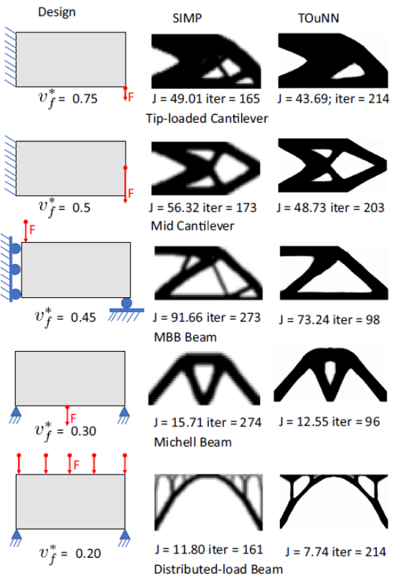
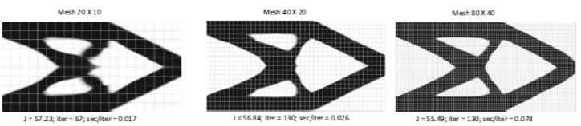
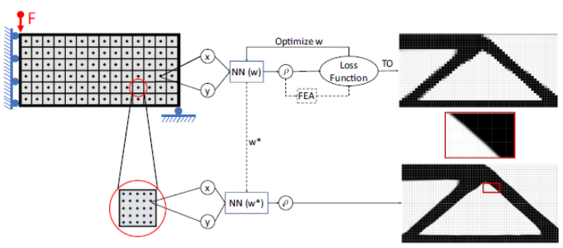
Experiments
Effect of mesh size
1. TO+GAN
2. TOuNN
Expandability to higher resolution

Slide 17
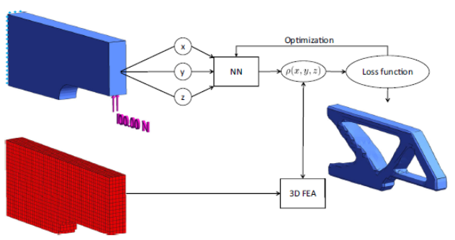
Experiments
Extensions to 3D
1. TO+GAN
2. TOuNN
Ease of additional design/manufacturing constraints
Symmetry
Non-design region
Extrusion

Slide 18
Pros and Cons
Pros
1. TO+GAN
- Ease application to higher resolution
- Extensions to 3D
- Ease of additional constraints
2. TOuNN
Cons
- Fail to converge for distributed load problem
- Twice computational cost compared to SIMP
- Lack of detailed features

